Slide 1
Unified Language Model Pre-training for
Natural Language Understanding and Generation
Li Dong，Nan Yang, Wenhui Wang, Furu Wei, et al. NeurIPS 2019
Bran
https://arxiv.org/abs/1905.03197
Notes:
Introduce a paper which I am reading in recent

Slide 2
Content
A disadvantage of BERT
UniLM
Pre-training and fine-tuning
Experiments
Conclusion

Slide 3
A disadvantage of BERT
XLMs
ELECTRA
GPT-2
WWM-BERT
ERNIE
SpanBERT
MT-DNN
BERT
LASER
ALBERT
MASS
XLNet
RoBERTa
ERNIE 2.0
……
Notes:
BERT is a good pre-trained LM. However, it has some disadvantages as well.
Xlnet avoid using mask tags
ERNIE knowledge graph
WWM, Span different mask strategy
ERNIE 2.0 continual learning
GPT-2 just unsupervised learning
ALBERT bert is too large
RoBERTa more data, bigger model
MT-DNN multi task learning
XLMs Cross-lingual Language Model Pretraining
ELECTRA improve the efficiency of BERT

Slide 4
A disadvantage of BERT
Problem:
BERT is difficult to be applied to natural language generation(NLG) tasks
Reason:
BERT is bidirectional and the objective is different from generation task’s.
We need extra decoder to generate sentences.
Other research shows BERT performs worse than unidirectional LM.
Notes:
We can still use bert for NLG tasks.

Slide 5
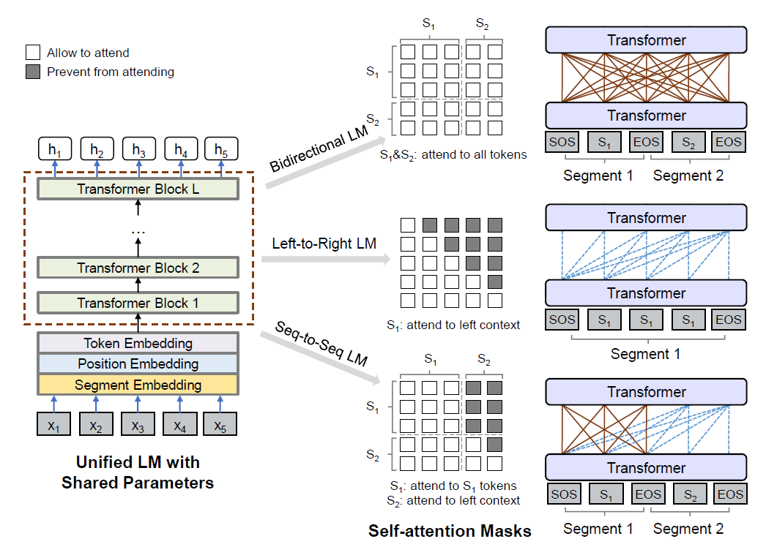
UniLM(Unified pre-trained language model)
Notes:
24-layers transformer with 1024 hidden size and 16 attention heads. 340M parameters
But they pre-trian it by Three different lm, shared transformer networks. So the model can be applied in different tasks.
Bi is exactly the same as BERT. They also do Next sentence prediction training
Uni, predict the input, randomly mask some tokens
Realize this by different mask matrix
Seq2seq, source sentence , target sentence(next sentence) packed
Token I, tokens j, mask matrix, add attention weight, ignore

Slide 6
Pre-training and fine-tuning
Pre-training objective
$${Objective}_{all}= {Objective}_{unidirectional}+ {Objective}_{bidirectional}+ {Objective}_{seq2seq LM}$$
1/6(L-to-R)
1/6 (R-to-L)
1/3
1/3
Initialization and training data
UniLM is initialized by BERT-large
Pre-trained by English Wikipedia and BookCorpus
Notes:
Sum of different LM objectives
In one training batch one sixth, one third

Slide 7
Pre-training and fine-tuning
Mask strategy
80% replace with [MASK]
10% replace with a random token
10% keep the same
80% mask one token
20% mask a bigram or a trigram
Pre-training
Batch size : 330
Max length: 512
Total steps: 770,000
GPU: 8 Telsa V100 (32GB)
Time: 22.5 days with mixed precision training (FP16)
Notes:
The mask strategy is the silimar with bert
Bigram and trigram can improve the ability to predict the tokens, bert+n-gram (ERNIE AND WWM-BERT)

Slide 8

Pre-training and fine-tuning
NLU tasks
[SOS]
Treat UniLM as an encoder
UniLM
CLS
Text classification
NLG tasks
For seq2seq problem, the fine-tuning part is similar with the seq2seq LM.
Summarization: s1 is the document and s2 is the summary
The second [EOS] token can also be masked. Learn when to end the generation.
Notes:
Mask some tokens and learn to recover the masked words

Slide 9
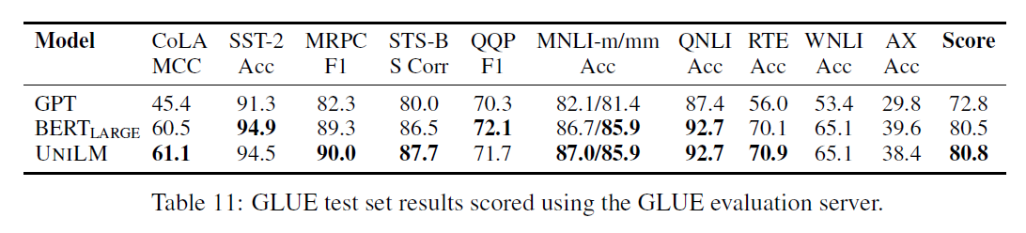
Experiments
NLU tasks: GLUE Benchmark
UniLM obtains comparable performance on the GLUE tasks in comparison with BERT-LARGE
Notes:
The scores are close
ALBERT 89.4
Electra 85

Slide 10
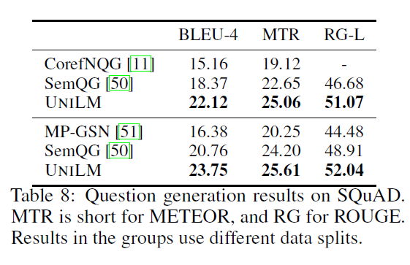
Experiments
NLG tasks: Question Generation
UniLM obtains better performance on the QG task in comparison with BERT
Notes:
SemQG uses BERT

Slide 11
Conclusion
UniLM performs well on NLG tasks
There are some disadvantage of UniLM: training and fine-tuning are slow, isn’t well enough on NLU tasks compare to NLG tasks.
It’s an alternative baseline for NLG tasks

Slide 12
Thanks

